Slide 1
Anchoring Synthetic DNA to a Membrane:
A Novel Application of Free Energy Perturbations
Ezry Santiago
Seminar Presentation
November 9, 2021

Slide 2
Motivation: Drug Delivery

Slide 3
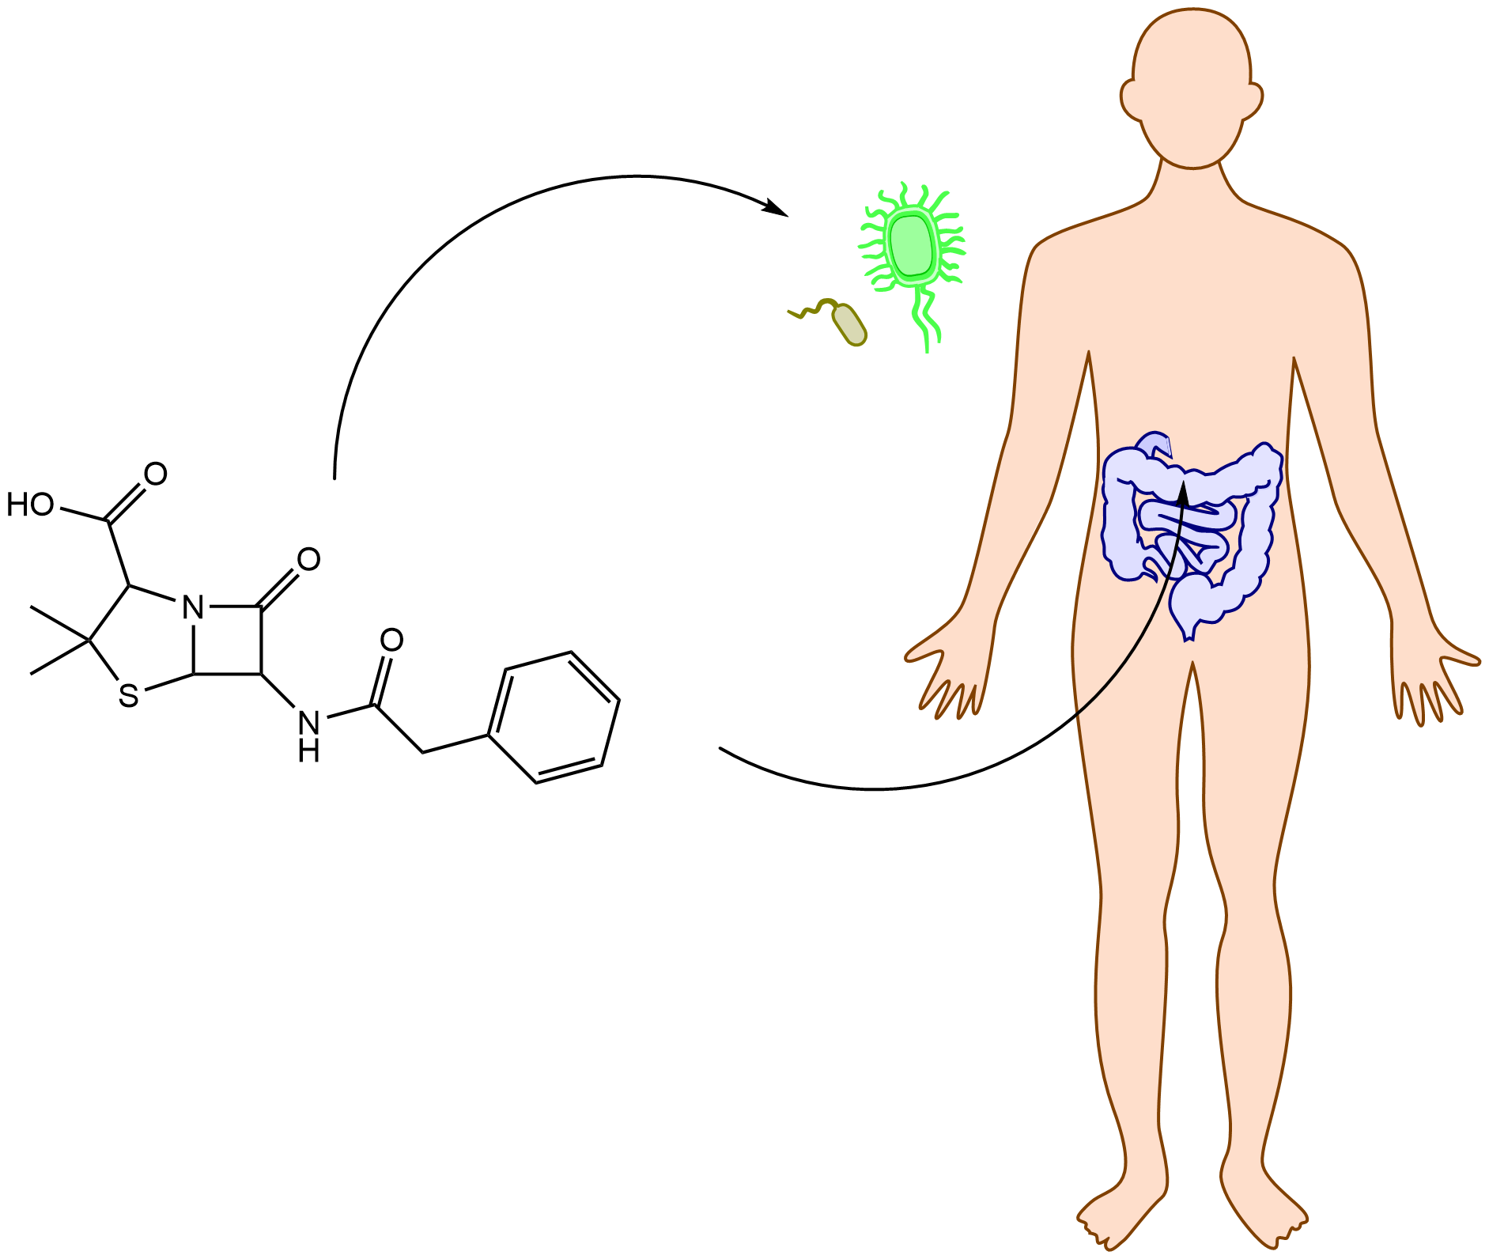
The Problem of Drug Delivery
The distribution of a drug in the body is hard to control.
Non-specific delivery leads to side-effects.
Antibiotic

Slide 4
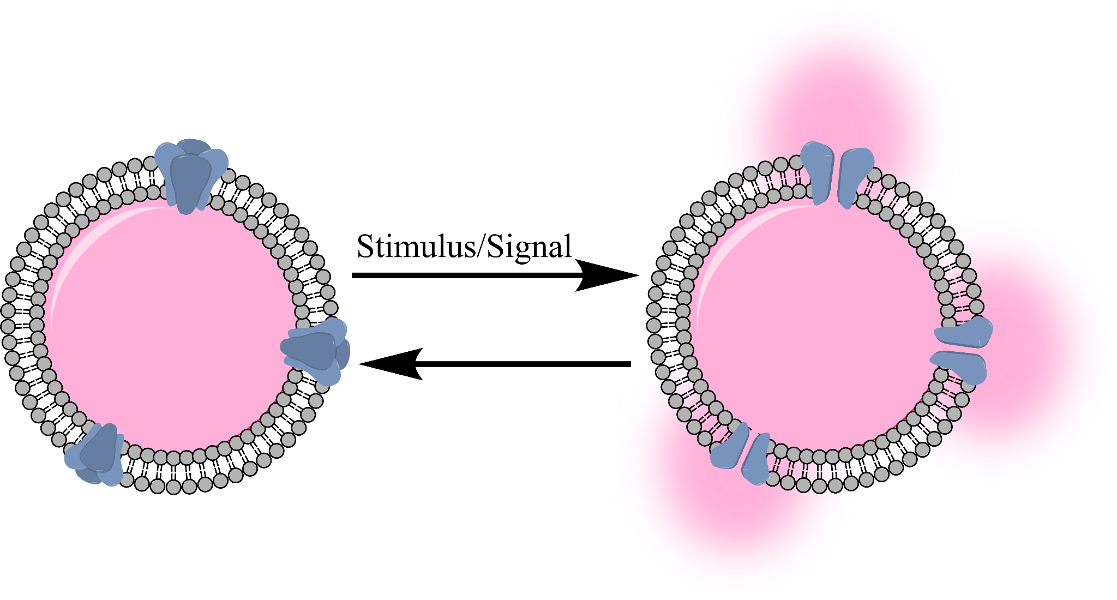
Simple Drug-Delivering Vesicle
Sensory molecules

Slide 5
Bottom-Up Design

Slide 6
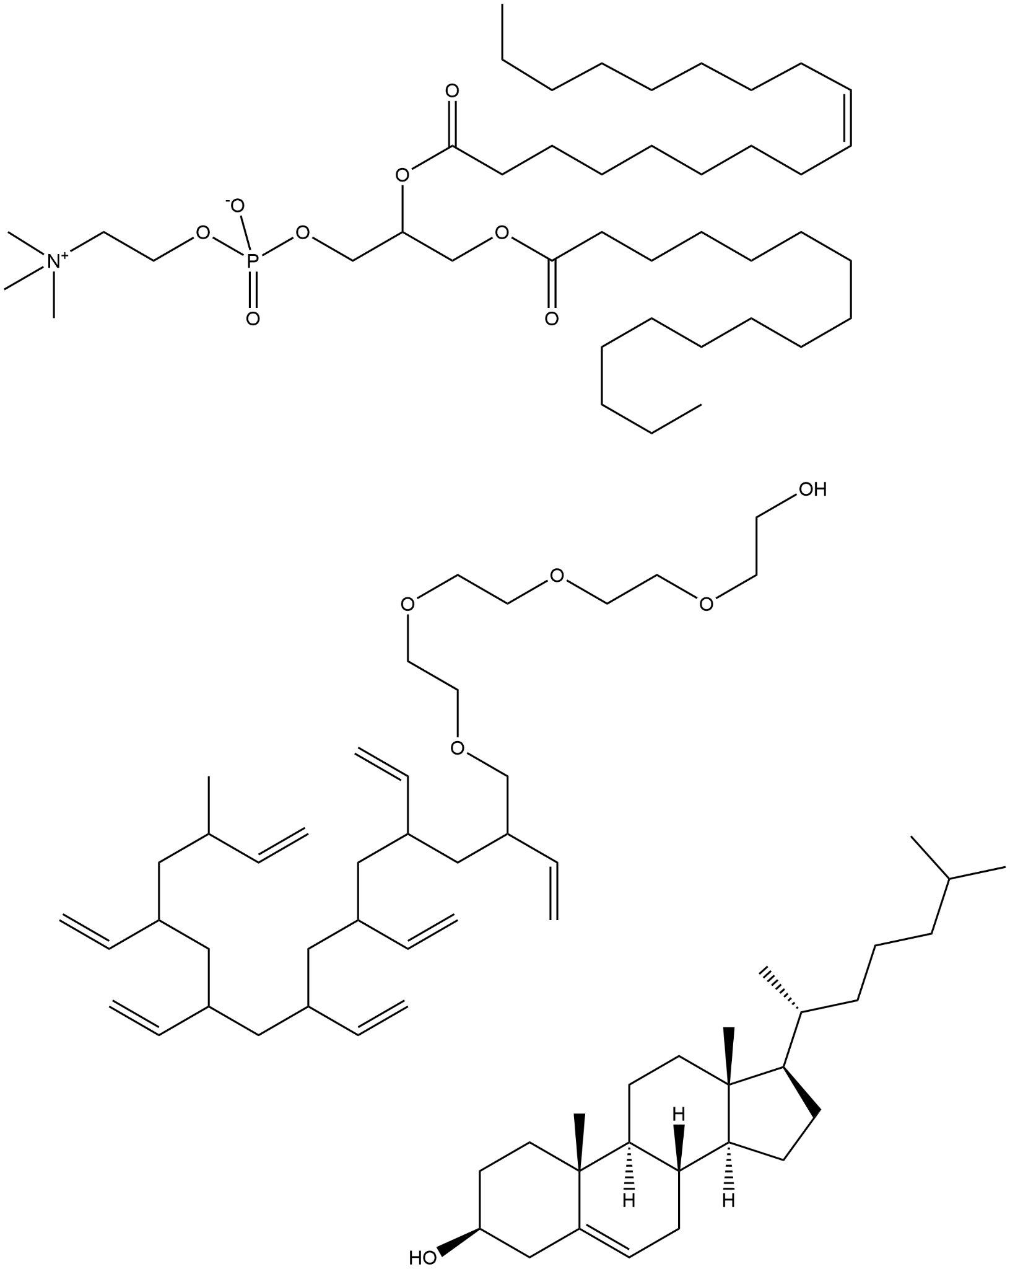
Polar Lipids (and other amphipaths)
POPC
Obvious choice for membranes
Cheap
Easy to manipulate
Stable and biocompatible
Polymer
Cholesterol

Slide 7
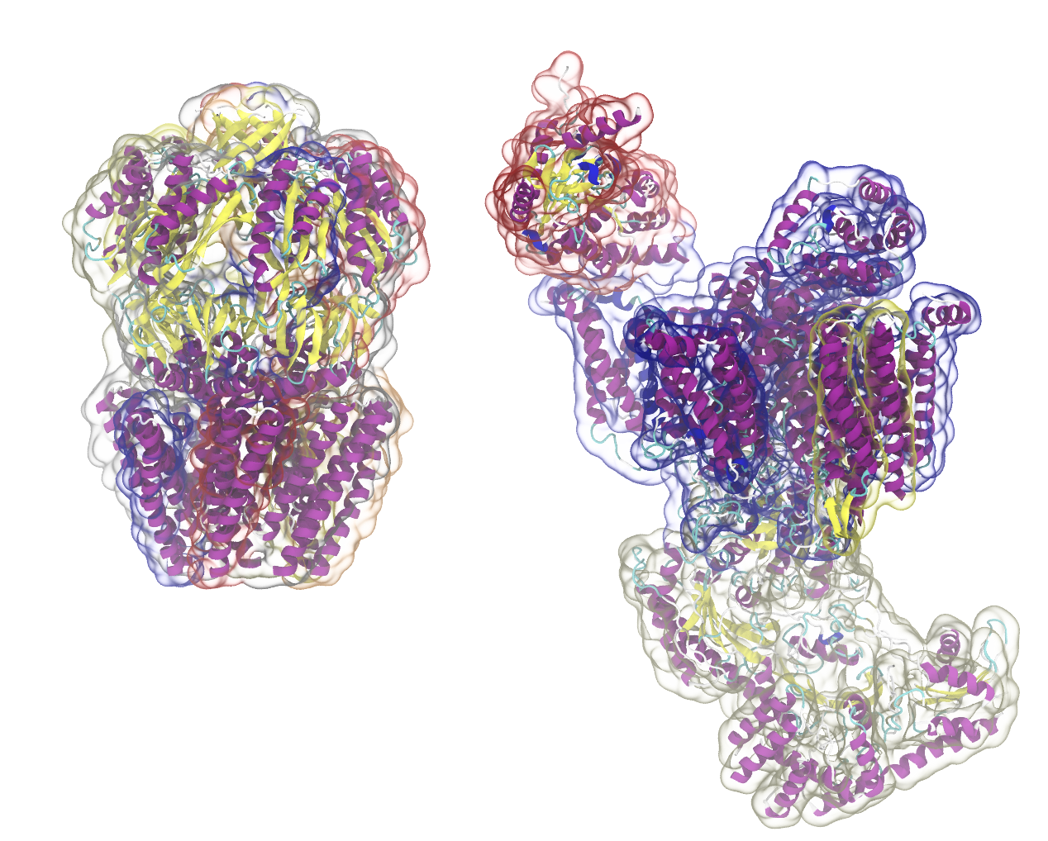
Proteins?
Pros:
Structural and functional
Diverse conjugation chemistry
Cons:
Difficult to design
Expensive to prototype
Structures: 2OAU (left) 3JBR (right)

Slide 8
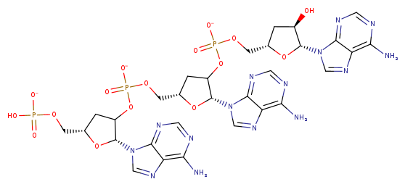
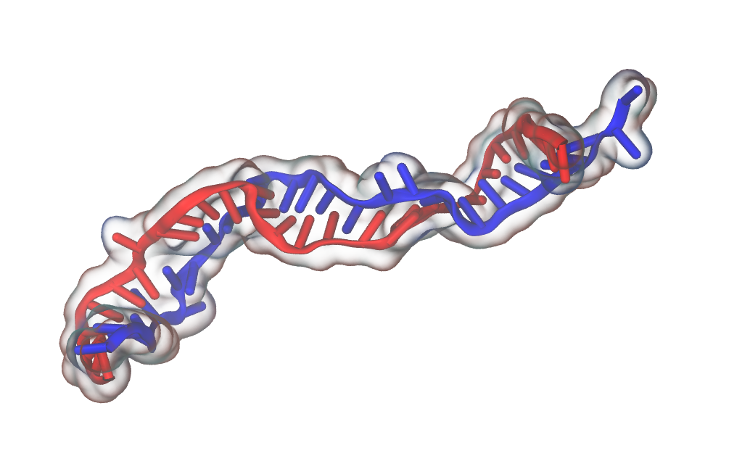
DNA nanotechnology
Pros:
Tractable design due to base-pairing
Both structural and functional
Diverse conjugation chemistry
Cons:
Less scalable
Polyanion

Slide 9
A Problem:
How can we get DNA to interact stably with the hydrophobic region of a membrane?

Slide 10
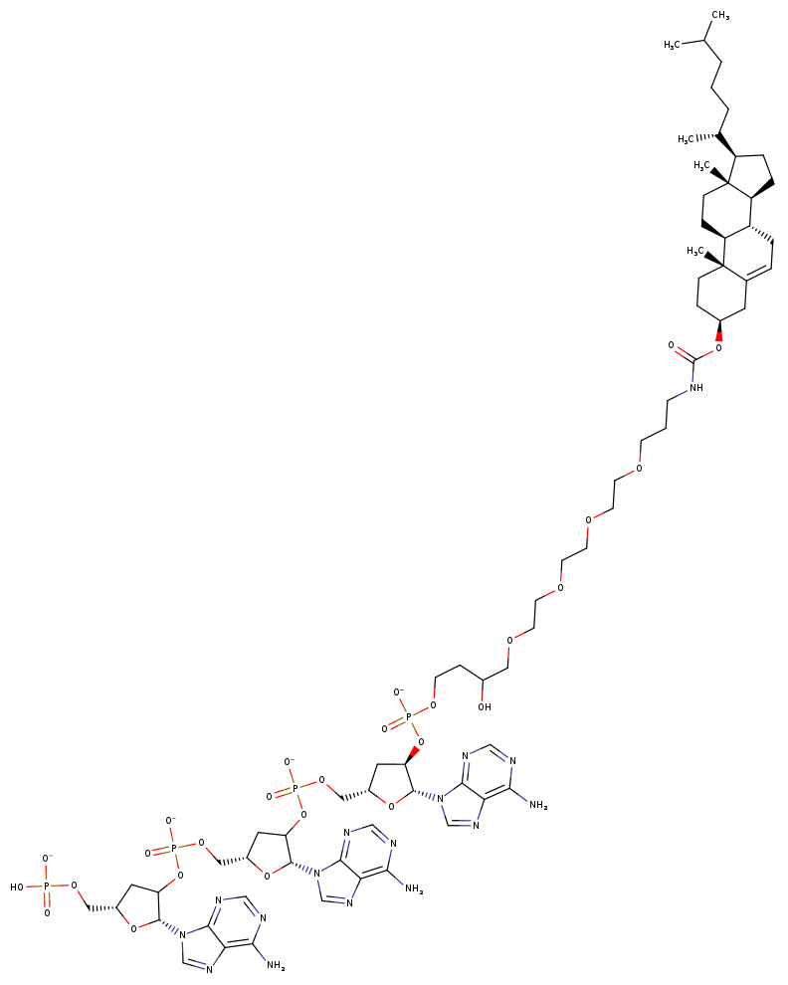
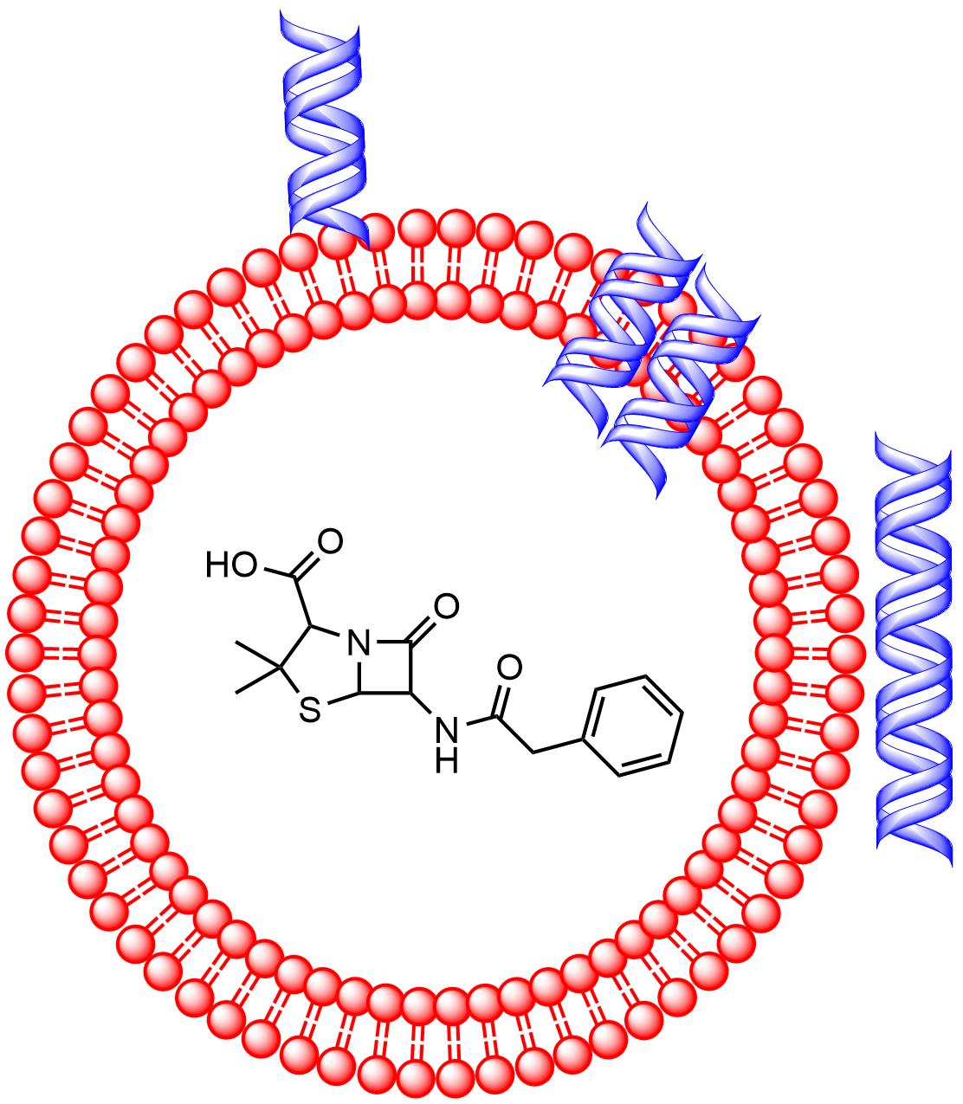
Prosthetic groups can act as anchors:
Prosthetic Groups
Chemical interfaces between DNA and other molecules
Notes:
Add drug delivery cartoon (replace penicillin with worse side effects)

Slide 11
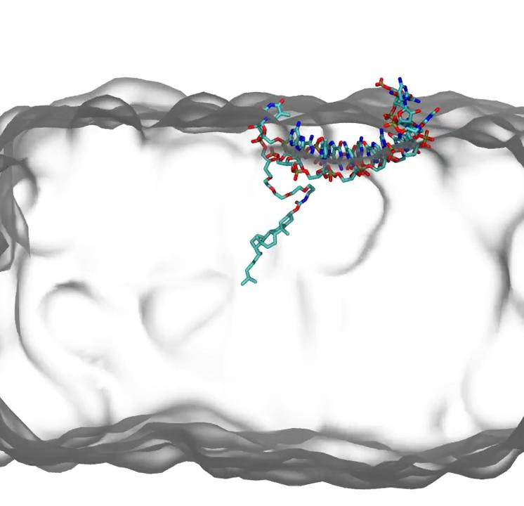
DNA Patched to a Membrane (MD Simulation)
Nitrogen
Oxygen
Carbon
Phosphorous
Lipids
Water not shown

Slide 12
The question:
Which prosthetic group stabilizes the DNA-Membrane complex most?

Slide 13
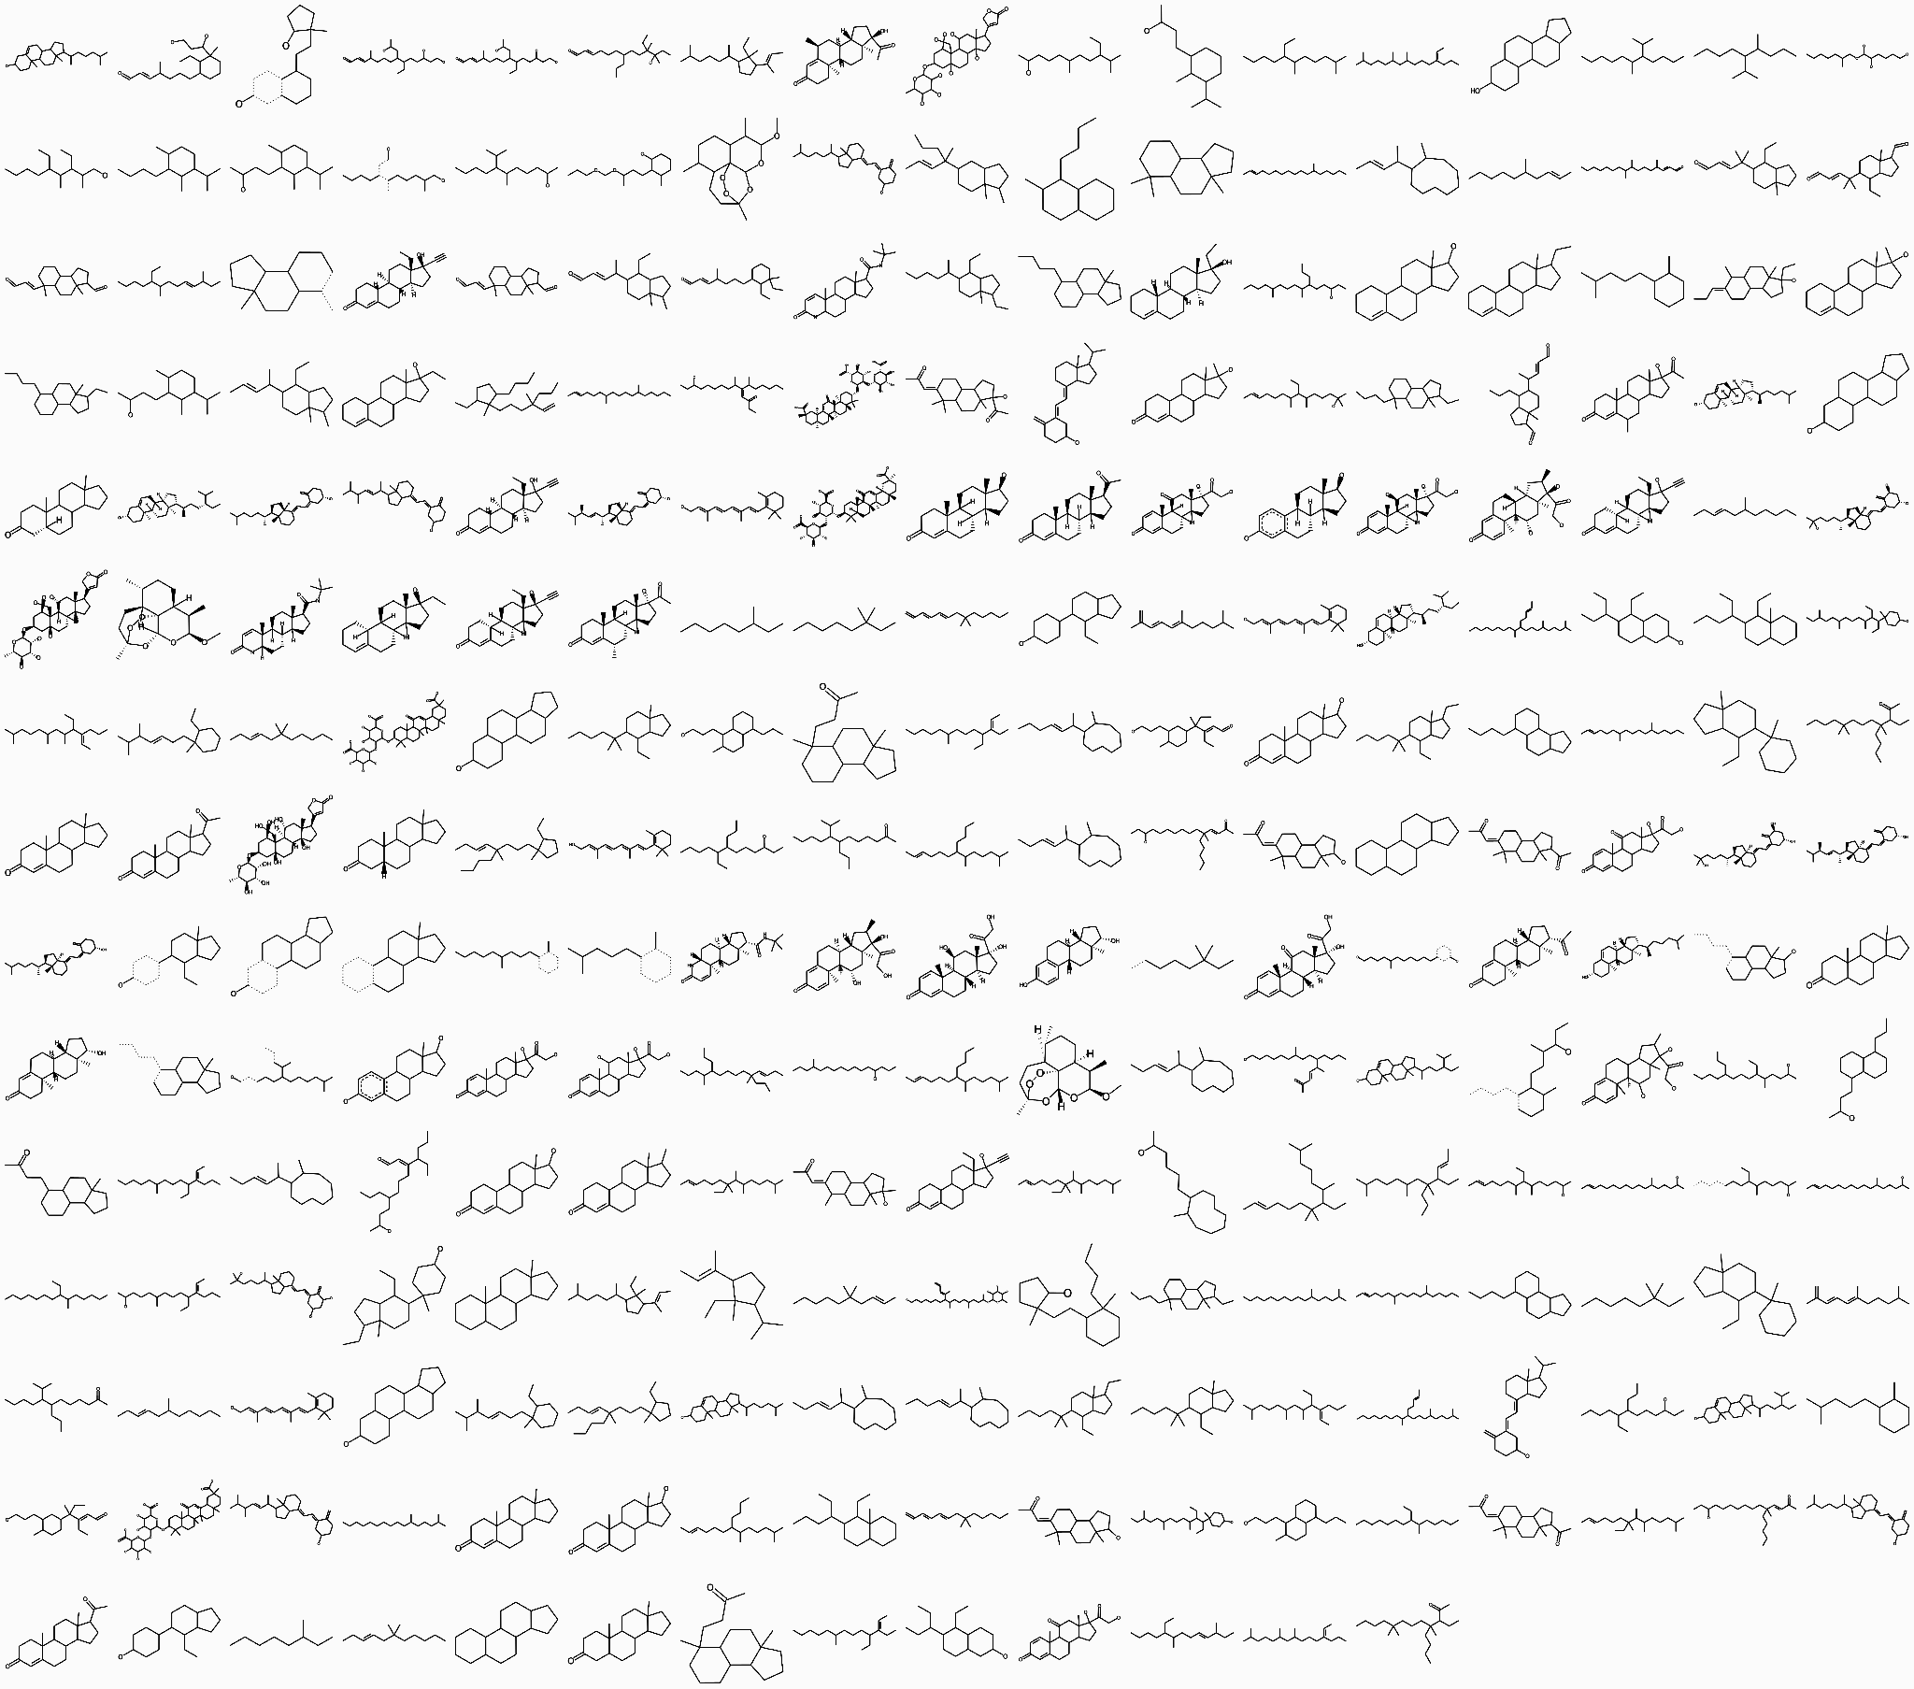
Current Problem: Which prosthetic group is optimal?
a small selection of possible prosthetic groups
(sterols and sphingosine derivatives)

Slide 14
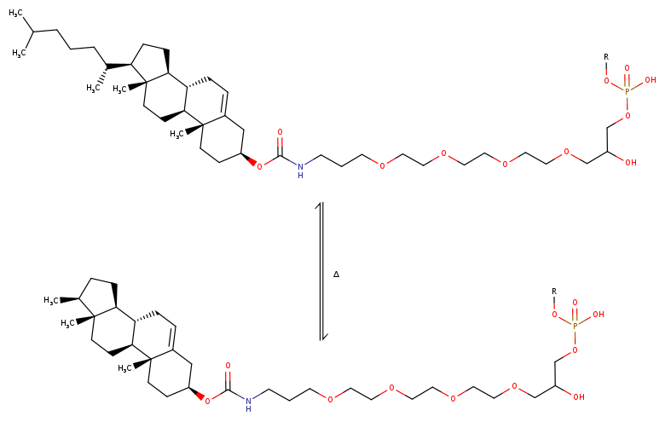
Which is Better: CholTEG or SterolTEG?
?
ΔGc
ΔGs

Slide 15
Our Approach:
Comparing Free Energies of Insertion

Slide 16
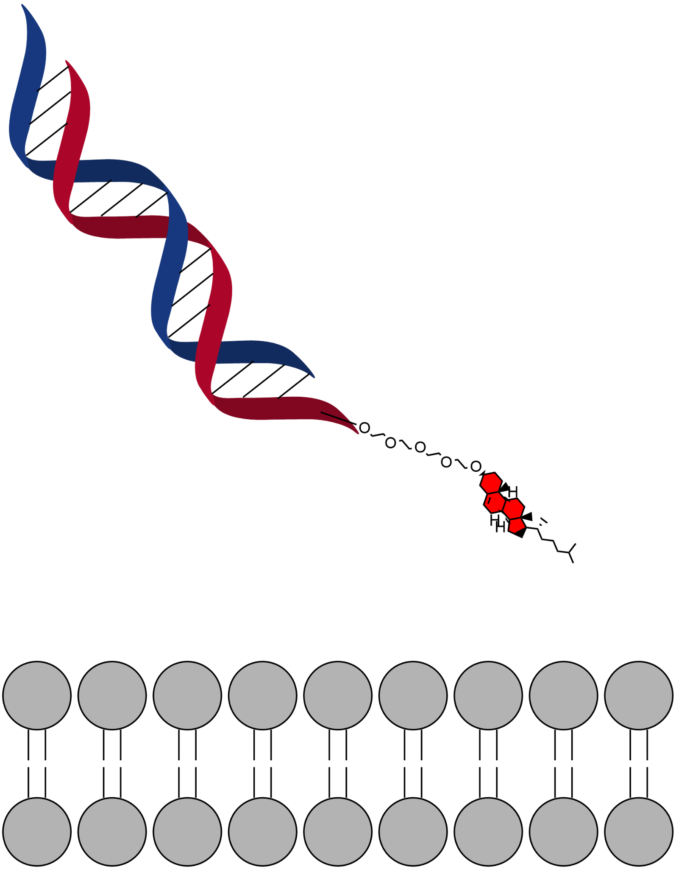
Free Energy Comparisons
Chol-TEG
Sterol-TEG
ΔΔG_{chol→sterol}=ΔG_{sterol}-ΔG_{chol}
ΔΔG<0 Chol is more stable
ΔΔG>0 Sterol is more stable
ΔG_{chol}
ΔG_{sterol}

Slide 17
Free Energy Calculations
Option 1: Spatial Method(s)
Example:
Push/pull the prosthetic group in/out of the membrane
Measure the resulting reactive forces to estimate the change in F over time
Sum the changes over dt to get the total
Repeat for each prosthetic group
Pulling Force
Images made with ChemDraw

Slide 18
Free Energy Comparisons: Thermodynamic Cycle
Chol-TEG
Sterol-TEG
-ΔG_{solvent}
ΔG_{chol} +ΔG_{membrane}-ΔG_{sterol}-ΔG_{solvent}=0
ΔΔG_{chol→sterol}=ΔG_{sterol}-ΔG_{chol}
ΔG_{chol}
-ΔG_{sterol}
ΔΔG_{chol→sterol}=ΔG_{membrane}-ΔG_{solvent}
ΔG_{membrane}

Slide 19
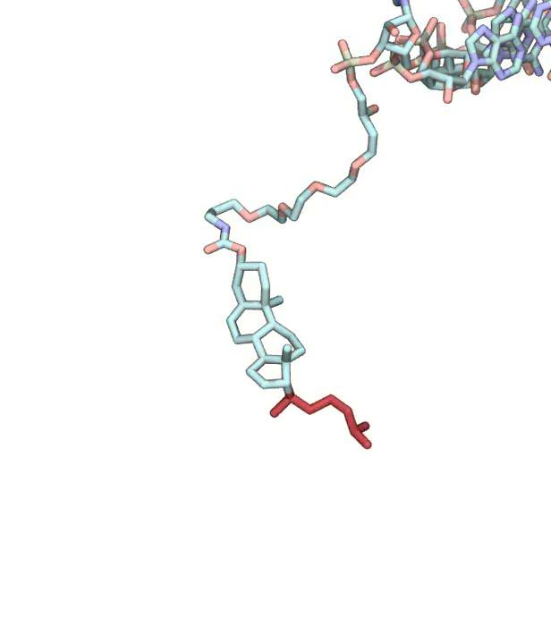
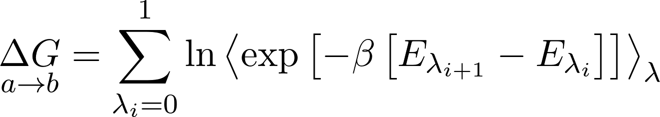
Getting ΔG_{membrane} and ΔG_{solvent}:
Alchemical Free Energy Calculations (FEP)
Decompose the two states into N intermediates: {λ₀,λ₁,λ₂...λ_{N}}
Simulate in state λ_{i}
Periodically calculate the internal energy (E) as if we were in state λ_{i+1}
Use the Boltzmann distribution to estimate ΔG(λ_{i}, λ_{i+1})
Sum over all substates

Slide 20
Uses and Challenges of Alchemical Free Energy Perturbations
Uses:
Traditionally used in drug discovery
Application to membrane dynamics is very new (<5 years)
When it works, it’s much more efficient than spatial methods
Challenges:
Windows can’t be too wide
Each window must be simulated for a sufficient time

Slide 21
Question:
Will FEP work in this system?

Slide 22
Two Main Criteria:
Convergence:
Does our estimate stabilize over simulation time?
Error:
How large is the remaining error?

Slide 23
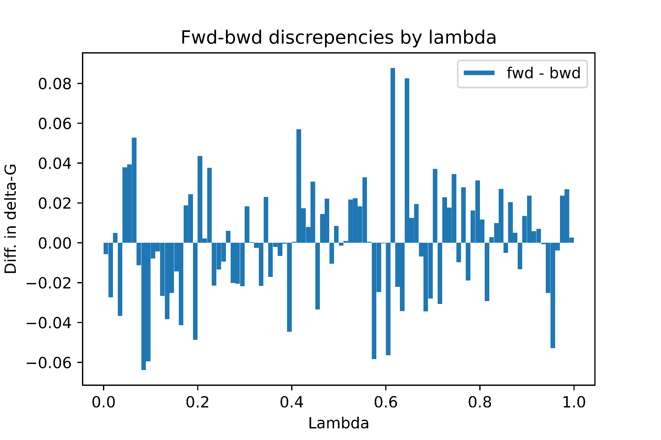
Hysteresis Plots and Convergence
For every pair λ_{i} and λ_{i+1}
With sufficient simulation time:
ΔG(λ_{i}, λ_{i+1}) = ΔG(λ_{i+1},λ_{i})
I.e. The calculation converges

Slide 24
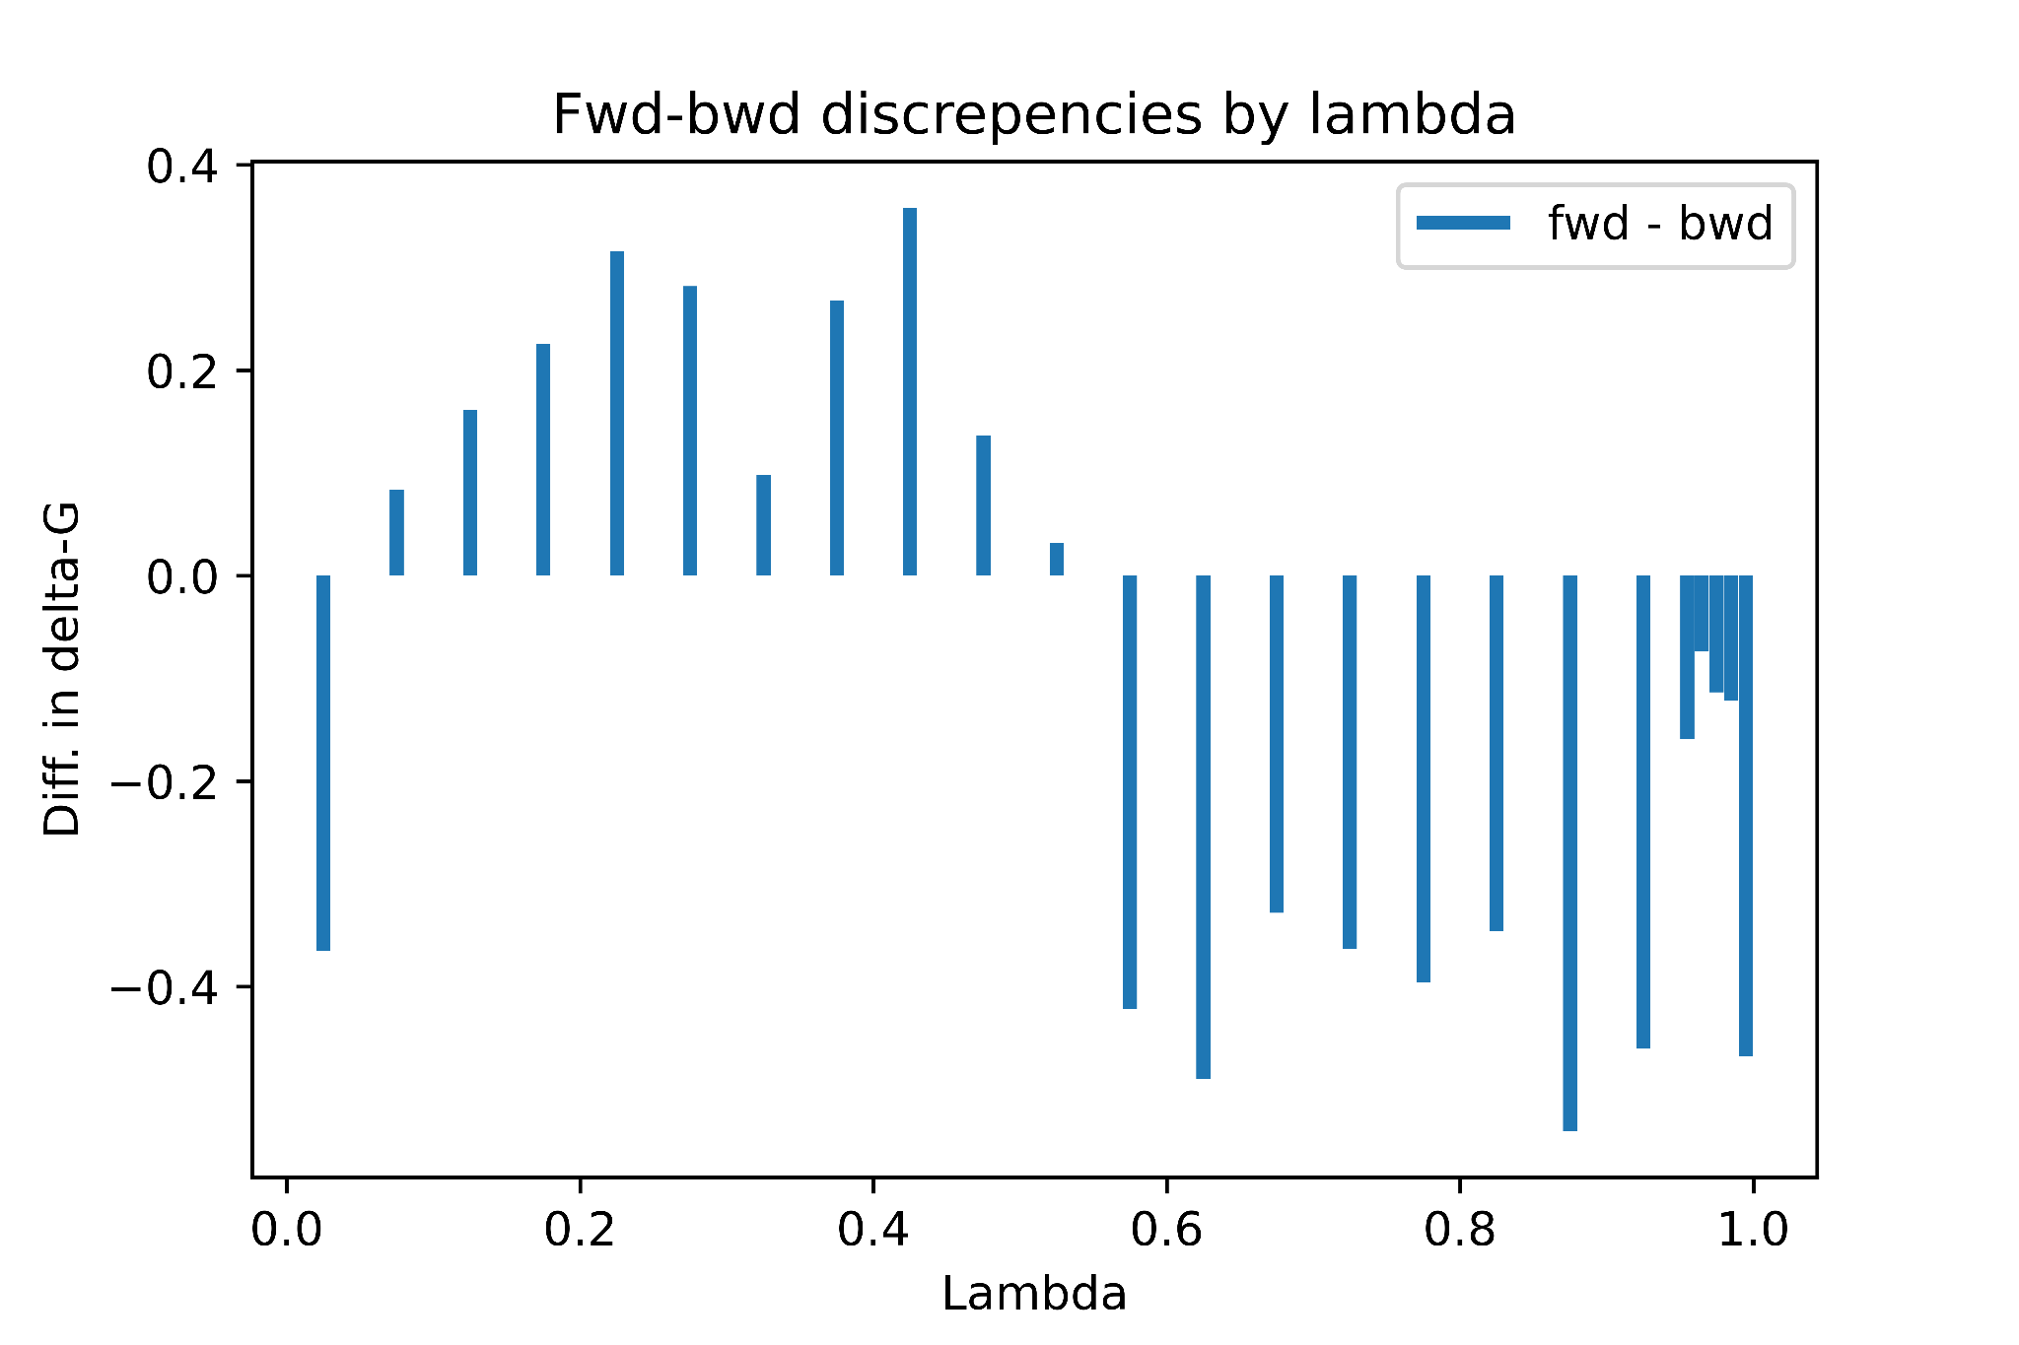
First Attempt (July)
Issues:
Differences are large
Sign switch near 0.5

Slide 25
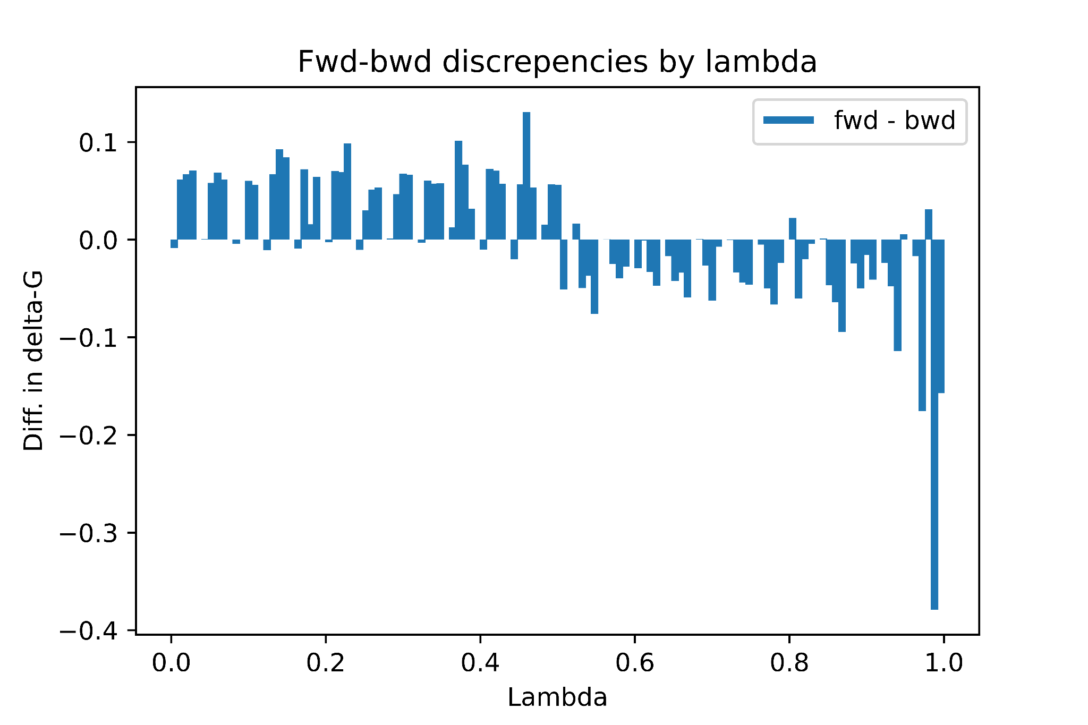
Second Attempt
Issues:
Differences are large
Sign switch near 0.5
Stubborn difference at 1

Slide 26
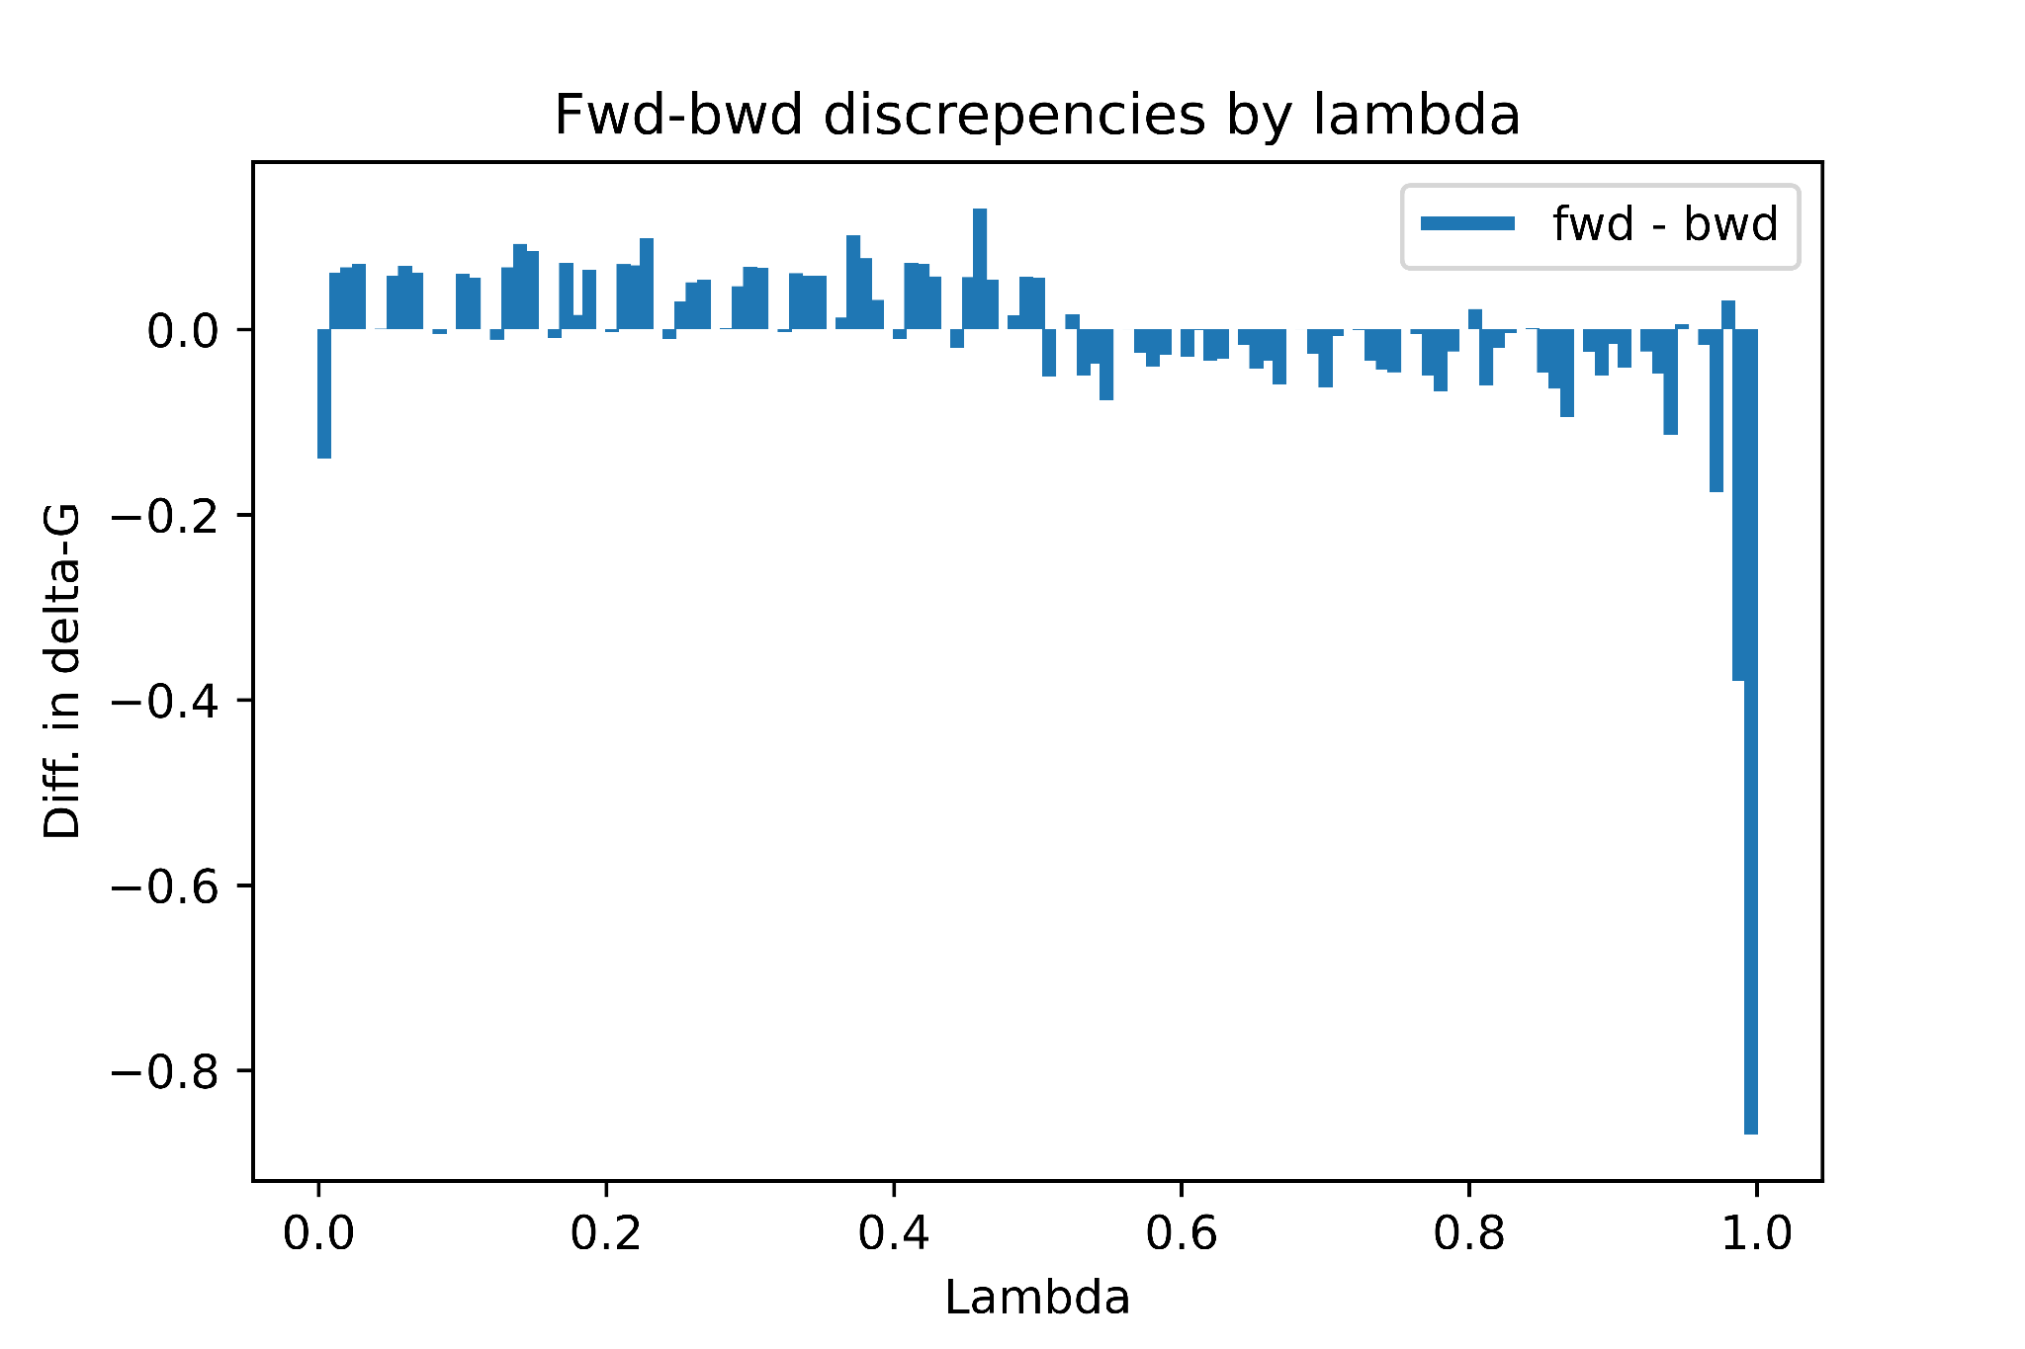
Penultimate Attempt
We tried everything
Issues:
Differences are large
Sign switch near 0.5
Stubborn difference at 1

Slide 27
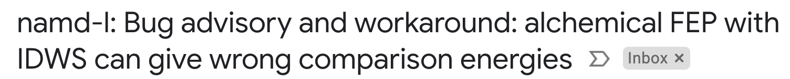
There was a bug in NAMD
With implications for many other labs

Slide 28
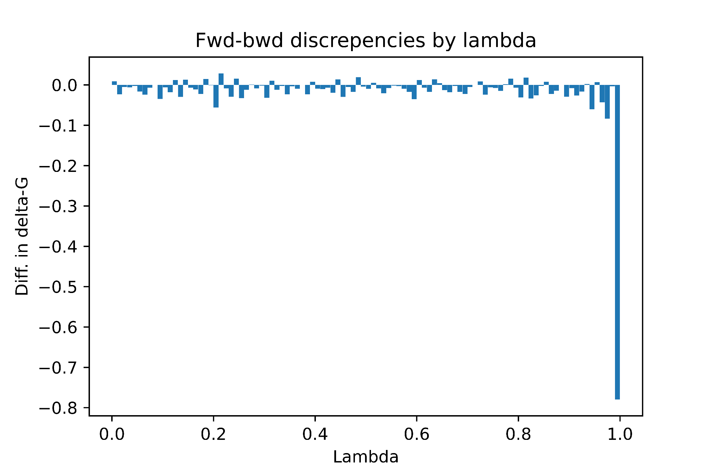
Latest Results (still running, preliminary)
Issues:
Differences are smaller still
Sign switch near 0.5
Stubborn difference at 1

Slide 29
Sterol is more stable in the membrane
ΔG_{mutation} = -1.6 + 0.6 kcal/mol
ΔG_{mutation}

Slide 30
Summary
Applicability
Cholesterol vs Sterol
Improvements
More Prosthetic Groups
We have demonstrated that free energy perturbation calculations converge (work) for these systems
We now know that a sterol-TEG is marginally more stable than chol-TEG in the membrane
Need to calculate ΔG_{solution}
Calculations still take several days. This can be improved.
Selection of more prosthetic groups is already underway

Slide 31
Acknowledgements
Advisors:
Dr. Grace Brannigan Primary Advisor
Dr. Jinglin Fu Secondary Advisor
Dr. Julie Griepenburg Collaborator
Dr. Jerome Henin Collaborator
Dr. Tom Joseph Collaborator
Lab Members:
Jesse Sandberg, MS
Connor Pitman
Jahmal Ennis
Resources:
Compute Resources: Office of Advanced Research Computing (OARC)
Funding: Department of Defence (DoD)

Slide 32
How do biological systems deliver metabolites across the body?

Slide 33
The biological approach (e.g. Oxygen Transport):

Slide 34
dE
dE
dE
dE
dE
Electrostatics
Electrostatics
Electrostatics
Electrostatics
Electrostatics
Lorem 1
Lorem 2
Lorem 3
Lorem 4
Electrostatics
Electrostatics
Lorem 3
Lorem 4
Lorem 5

Slide 35
Outline
Introduction:
Big-picture - moving and manipulating small groups of molecules
Biological inspiration - vesicles and associated proteins
Our toolbox - DNA, chemical modifications, and synthetic vesicles
Problem statement: optimizing prosthetic groups
Approach: Collect and organize candidates
Compare the free energies of solvation for various prosthetic groups
Energy components
Methods: Free energy perturbation (compare and contrast with LogP)
Results: Convergence and hysteresis?

Slide 36
Applicability of FEP:
Proposed
Tested
Published
0
Equations of state
✔
✔
1954
RW Zwanzig
1
Calculation of partition coefficients (ΔG_solvation)
✔
✔
✔
2
Ligand Binding in Dilute Aqueous Solution (ΔG_binding)
✔
✔
✔
3
Ligand Binding in Heterogeneous, Non-Dilute Systems
✔
✔
2018
Salari et al.
4
Patching on Membranes
✔
This work
✖
5
Insertion of Transmembrane Macromolecules
✔
Upcoming
✖

Slide 37
Ensuring Convergence and Reducing Error
Our “Best Practices” so far:
Sample frequently
~every 16-20 fs
Use double-wide sampling
Simulate intermediate state N while sampling N-1 and N+1
Equilibrate thoroughly
Initially ~100ns
~10ps for each window
Use long enough sampling times (~2ns)
Use small windows to ensure good overlap (~100 divisions between A and B)

Slide 38
Add thermodynamic cycle
Add movie of mutation
Add slide numbers
Define convergence

Slide 39
Free Energy Comparisons
ΔG_{mutation}
ΔΔG_{mutation}
ΔΔG_{mutation}=ΔΔG_{patching}
ΔΔG_{patching}
ΔG_{patching}
ΔG_{patching}
ΔG_{mutation}

Slide 40
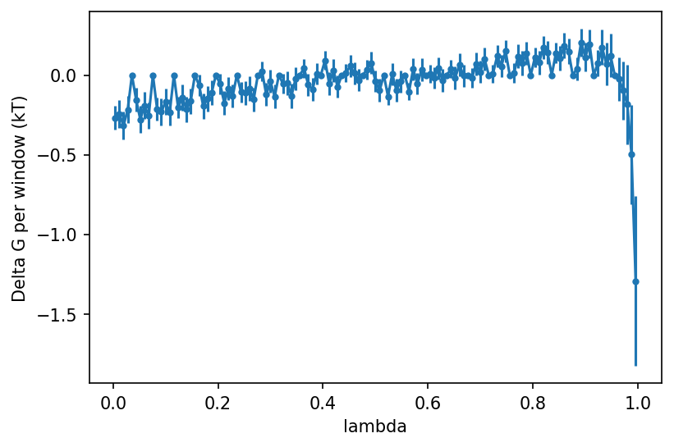
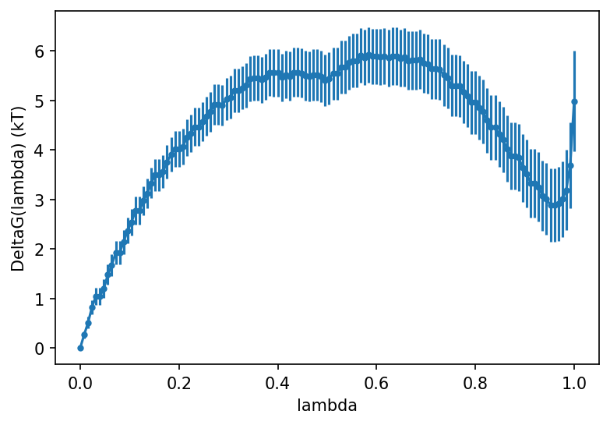
Best estimate so far:

Slide 41
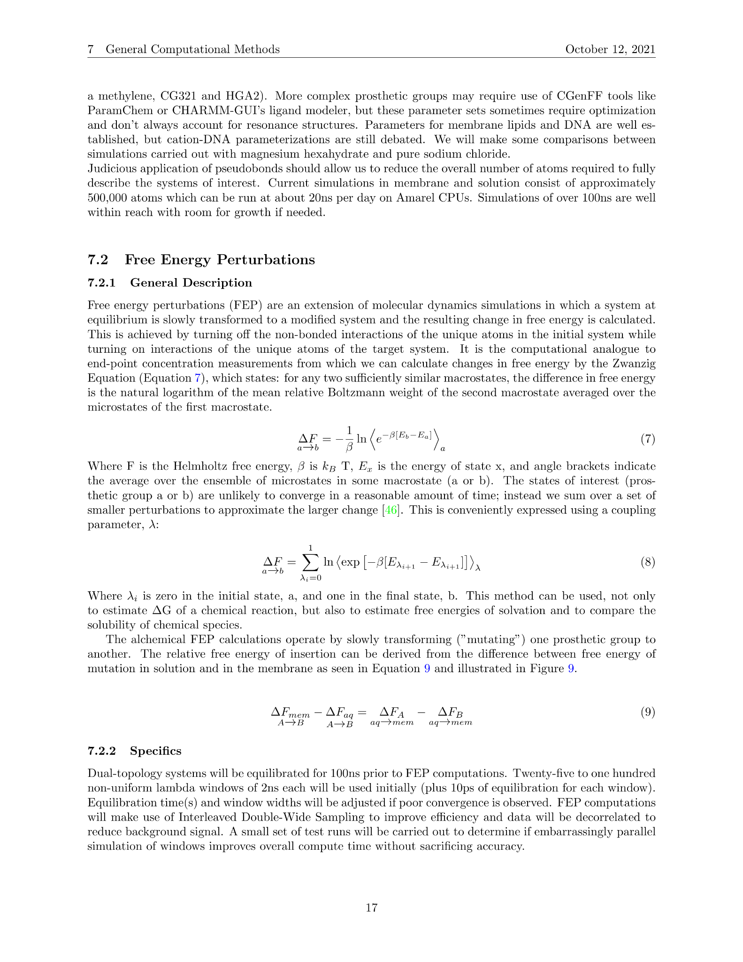
Combining DNA and Membranes
Nitrogen
Oxygen
Carbon
Phosphorous
Lipids
Refinement: decompose the two states into N intermediates: {λ₀,λ₁,λ₂...λ_{N}}
Simulate in state A
Periodically calculate the internal energy (E) as if we were in state B
Use the Boltzmann distribution to estimate dF

Slide 42
AFEP: a closer look
Nitrogen
Oxygen
Carbon
Phosphorous
Lipids

Slide 43
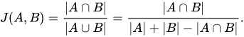
Organization Paradigms
by size Maximum Common Structure:
by Tanimoto Distance:
Basic cheminformatics:
by MCS with tuning by CHARMM parameter distances:
A, but including CHARMM parameters as additional data

Slide 44
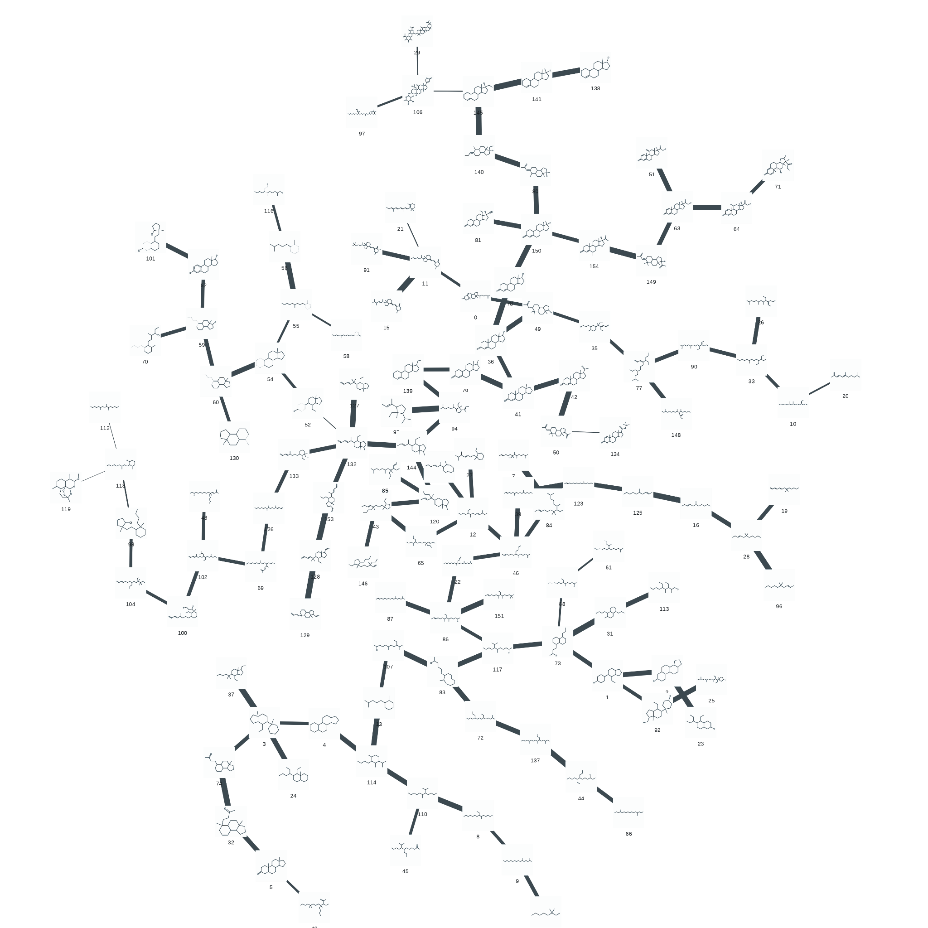
Approach
Organize candidate prosthetic groups
Compute the relative free energies of solvation/insertion for each

Slide 45
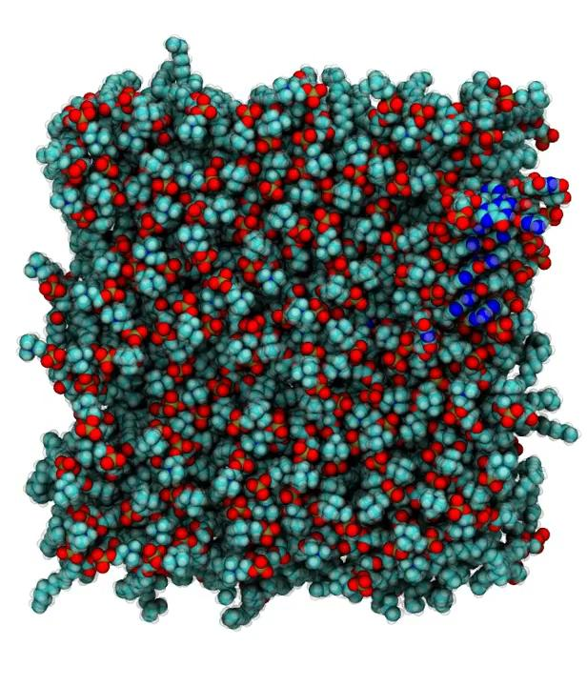
Methods: Simulation
Nitrogen
Oxygen
Carbon
Phosphorous
Lipids

